Slide 1


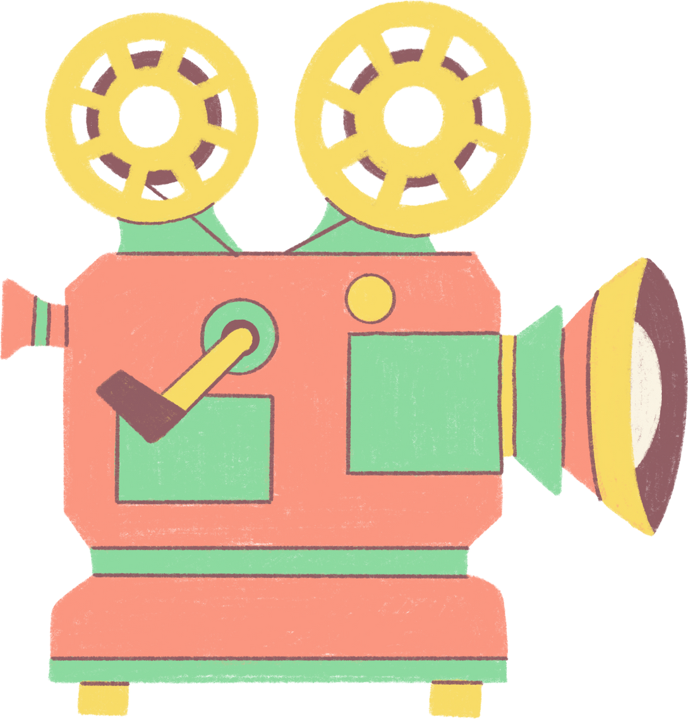
GROUP 9
MOVIELENS RECOMMENDATION SYSTEM

Slide 2

TABLE OF CONTENT
1.
3. Data Understanding
5. Modeling
Business understanding
2. Problem statement
4. Data Preparation
6. Conclusions
7. Recommendations

Slide 3
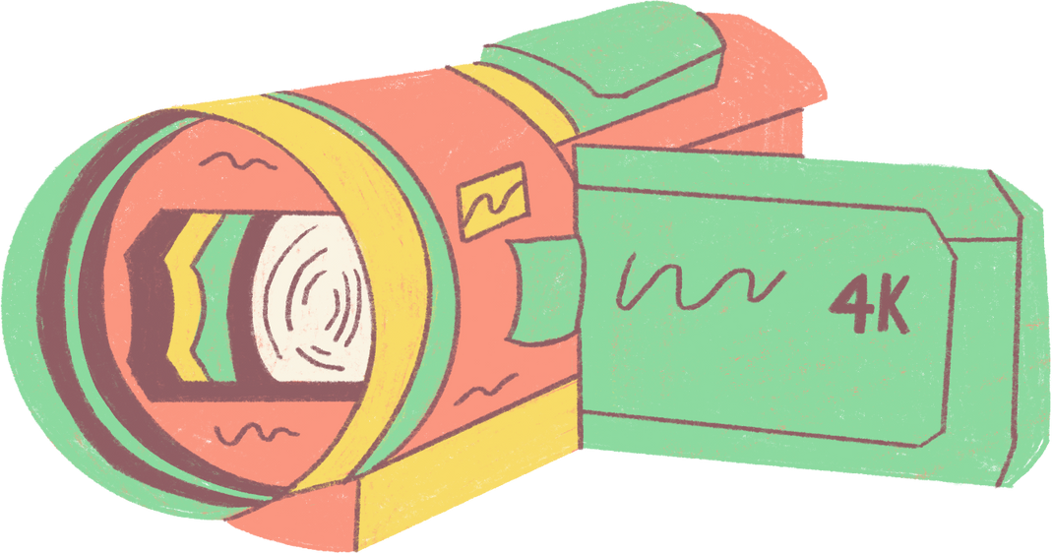
BUSINESS UNDERSTANDING
In the vibrant entertainment industry, user engagement reigns supreme. To excel, we must explore user history for insights into viewing habits, genres, and optimal content times.
Our aim: a state-of-the-art movie recommendation system for unparalleled personalized suggestions, elevating user engagement.

Slide 4
PROBLEM STATEMENT
To achieve this objective, we seek to build an advanced recommendation system that provides users with top 5 movie recommendations based on their historical movie ratings and interactions.
:Challenges and Goals:
1.
2. User Engagement
3. Collaborative Filtering
Personalization
Tailor the recommendations to each user's preferences, ensuring that the suggested movies align with their past interactions and ratings.
Focus on enhancing user engagement by delivering relevant and appealing movie suggestions, which in turn prolongs user interactions with the platform
Implement a collaborative filtering algorithm that accurately predicts movie ratings for users based on their historical ratings of other movies.

Slide 5


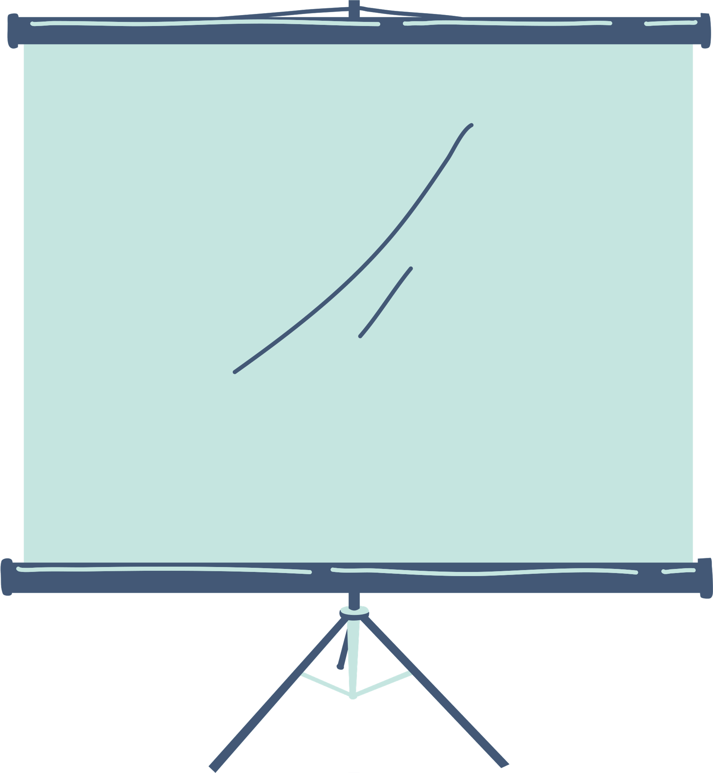
DATA UNDERSTANDING
The MovieLens dataset from the University of Minnesota serves as the foundation for this recommendation system. The dataset consists of three main components: movies, ratings, and links. These components provide comprehensive information about user interactions and preferences within the movie platform.
MOVIES
The movies dataset includes information about each movie, such as movie ID, title, and genres. This dataset helps enrich the recommendations by providing details about the movies themselves
RATINGS
The ratings dataset contains user-movie interactions, including user IDs, movie IDs, and ratings. Collaborative filtering algorithms will leverage this dataset to predict movie ratings for users based on their historical ratings.
LINKS
The links dataset comprises links between movie IDs in the MovieLens dataset and external movie databases. This dataset might offer additional contextual information for content-based filtering, especially for new users.

Slide 6

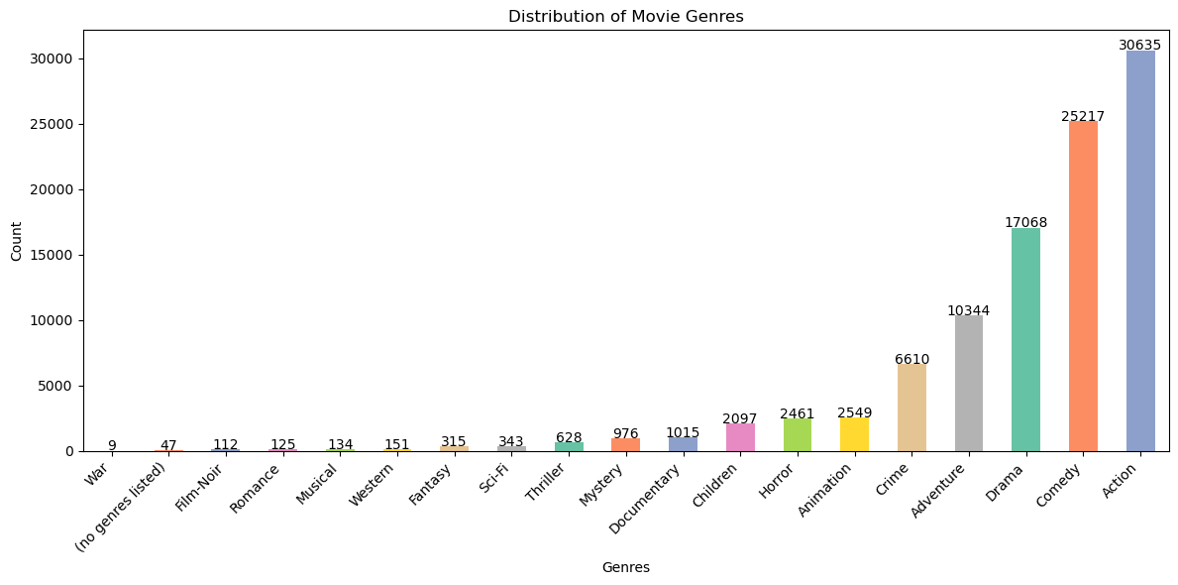
DISTRIBUTION OF MOVIE GENRES
Movies with action as a genre recorded the highest count whereas movies with war as the genre had the lowest count.

Slide 7
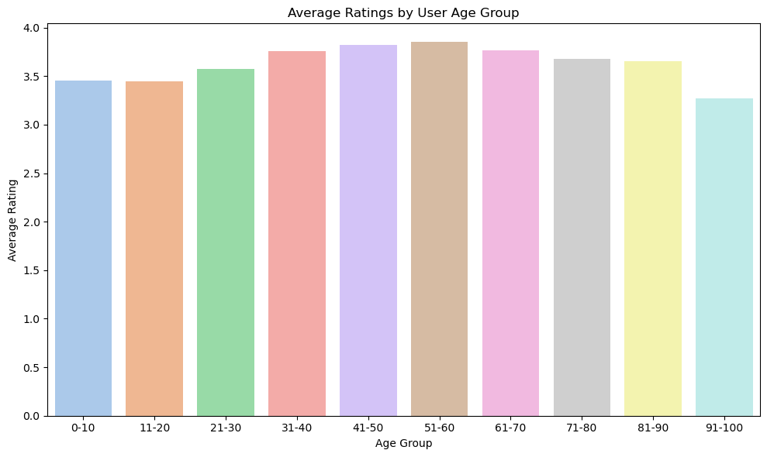
AVERAGE RATINGS BY AGE GROUPS
People aged between 51-60 had the highest average movie rating
The lowest movie rating came from people aged between 91-100

Slide 8
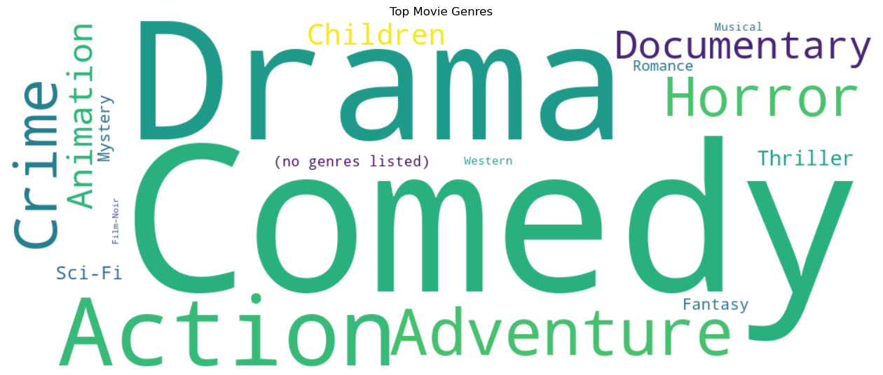
GENRE WORDCLOUD
The following visualization is a word cloud of movie genres.
It works by displaying the genres relative to the frequency of that genre in the dataset

Slide 9
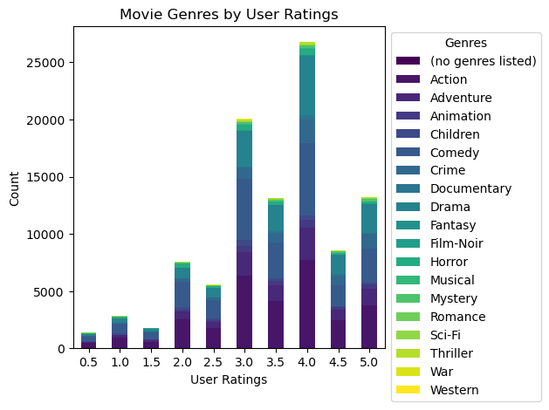
MOVIE GENRES BY USER RATINGS
From the visualization, majority of user ratings came from column 4
The lowest number of user ratings was in column 0.5

Slide 10
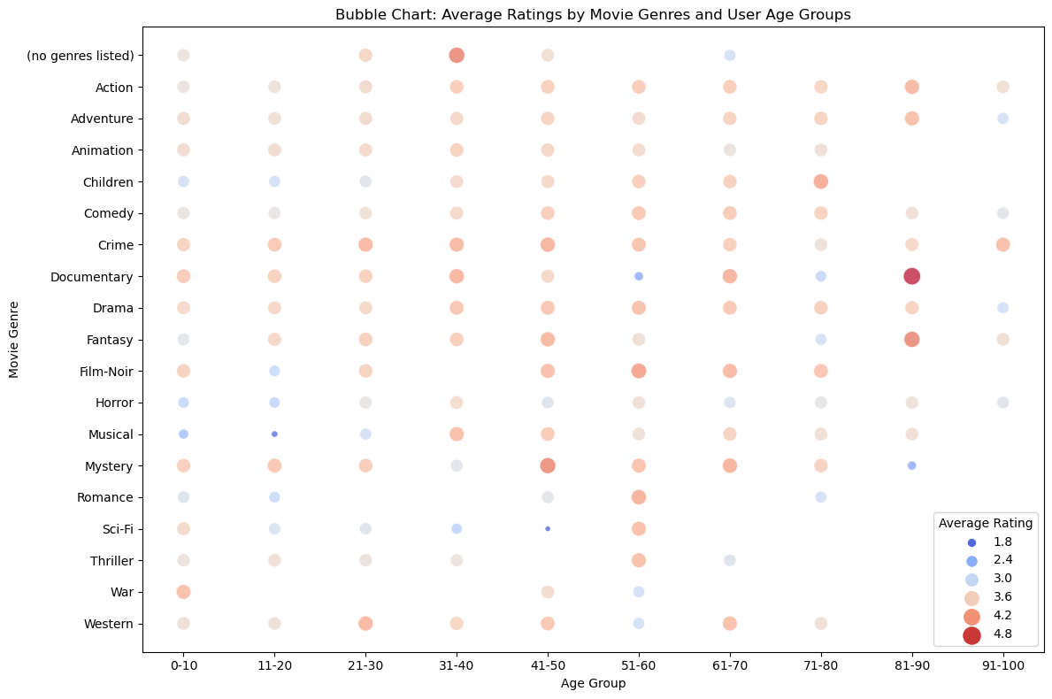
AVERAGE RATING BY MOVIE GENRE AND AGE GROUPS
Individuals aged 51-60 had the highest score in giving movie rates.
Individuals aged 91-100 years had the lowest score in giving movie rates.

Slide 11
Data Modelling
Approaches used here include:
Collaborative Filtering
Content-Based Filtering

Slide 12
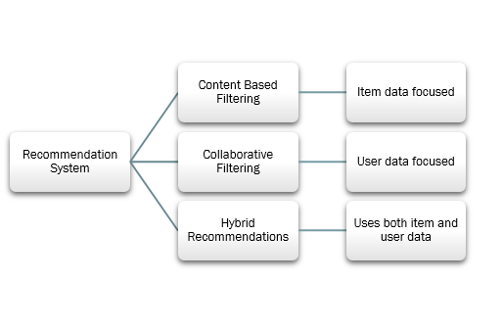

Slide 13
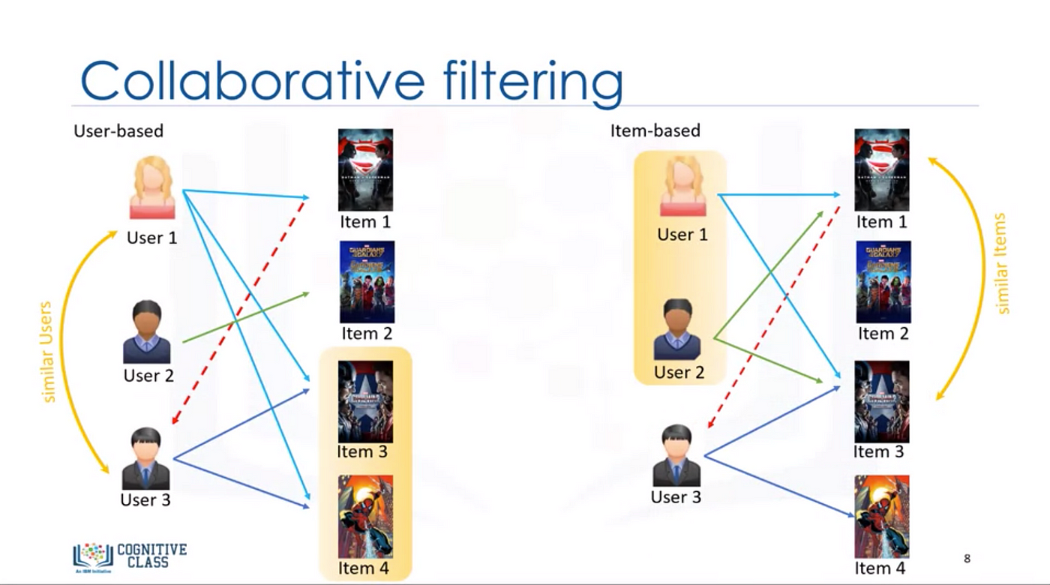
COLLABORATIVE FILTERING
Collaborative filtering is a technique used in movie recommendation systems to suggest movies to users based on the preferences and behaviors of similar users. It relies on the idea that if two users have liked or disliked similar movies in the past, they are likely to have similar preferences for future movie choices as well.

Slide 14
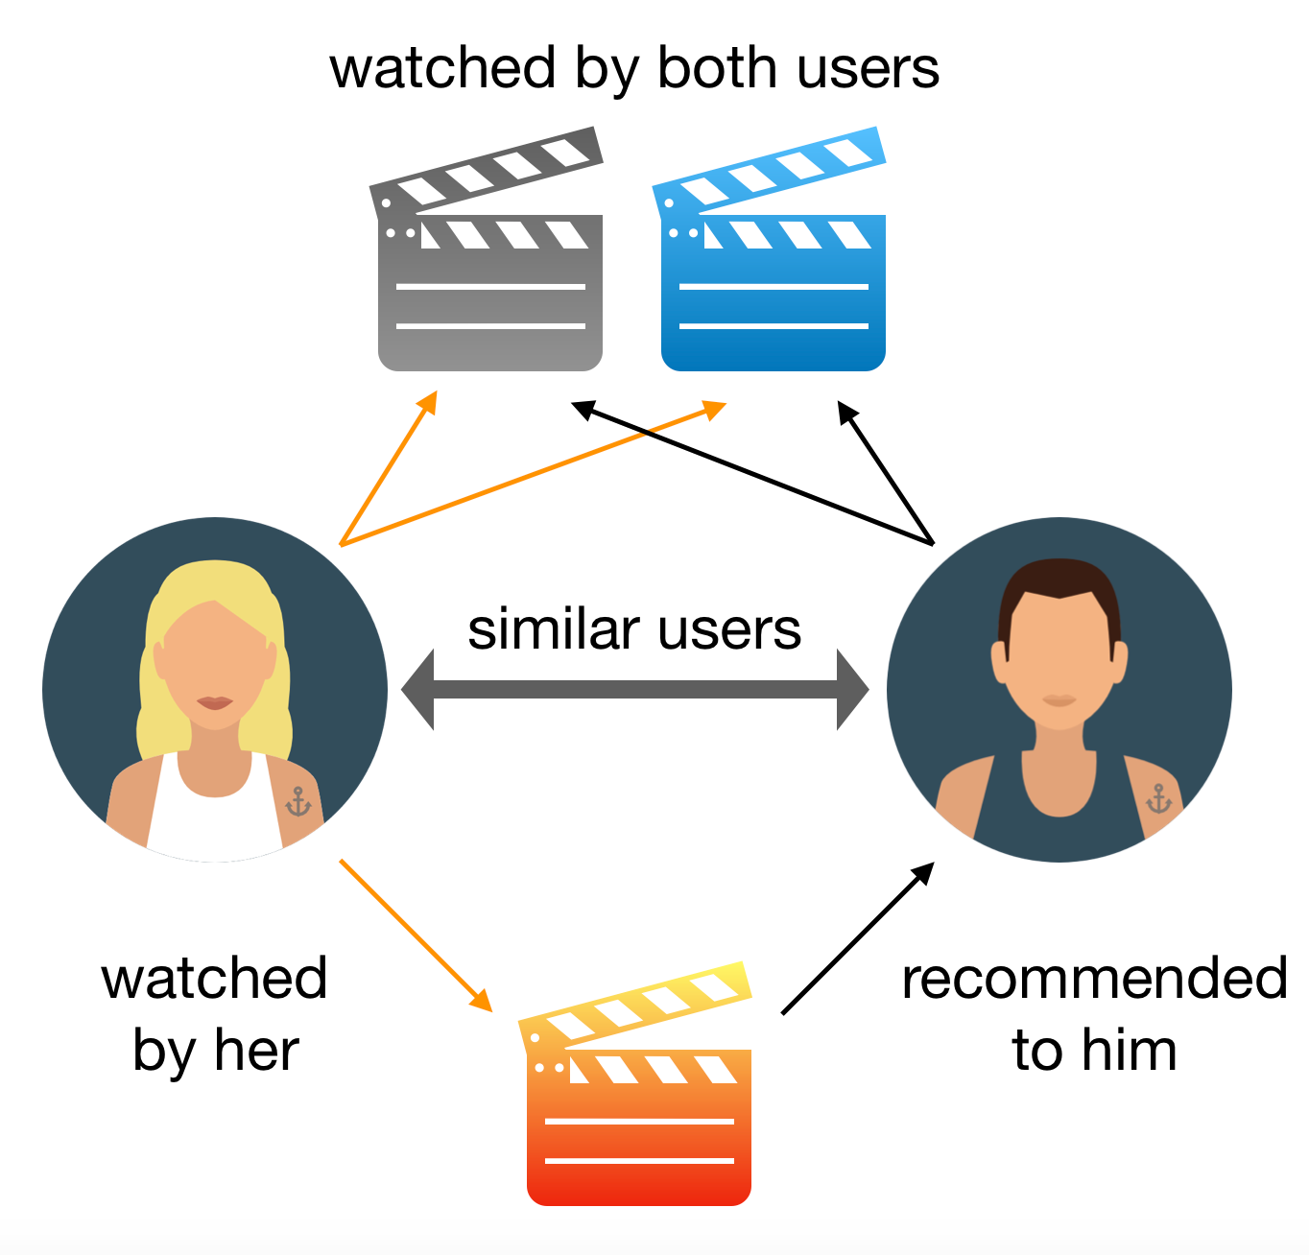
CONTENT BASED FILTERING
Content-based filtering in movie recommenders works like a movie-savvy friend – it suggests films similar to ones you like by focusing on details like actors, genres, and themes. It's like getting tailored movie suggestions based on what you already enjoy.

Slide 15

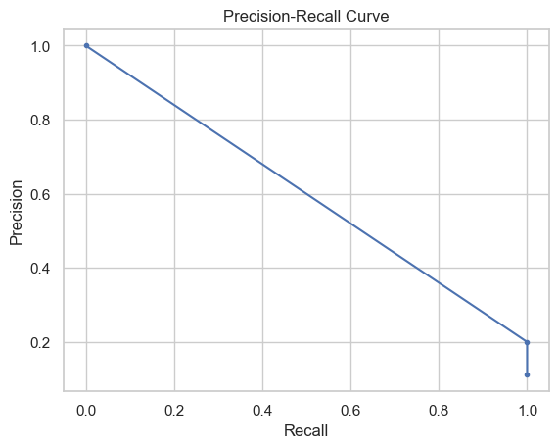
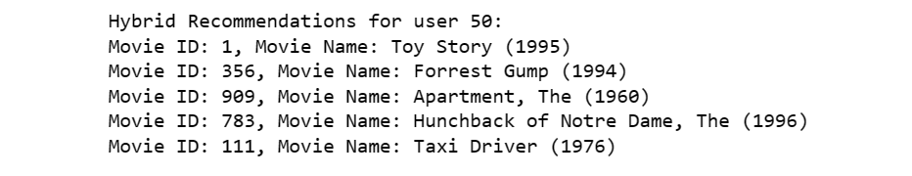
RESULTS

Slide 16

CONCLUSIONS
Personalized Engagement Strategy: Our focus on personalized engagement is driven by the ever-changing entertainment landscape and user demands. Utilizing historical interactions, we've built a recommendation system that offers customized movie suggestions, vital for captivating our audience
Collaborative Filtering Prowess: Central to our strategy is collaborative filtering, which deciphers intricate user patterns to predict accurate preferences. This technique harnesses shared tastes, forming the foundation of our successful recommendation system.
Hybrid Approach for Holistic Reach: Recognizing the challenge of engaging new users, our hybrid approach combines collaborative filtering with content-based methods. This ensures inclusivity, catering to diverse users and delivering comprehensive recommendations despite limited historical data.

Slide 17
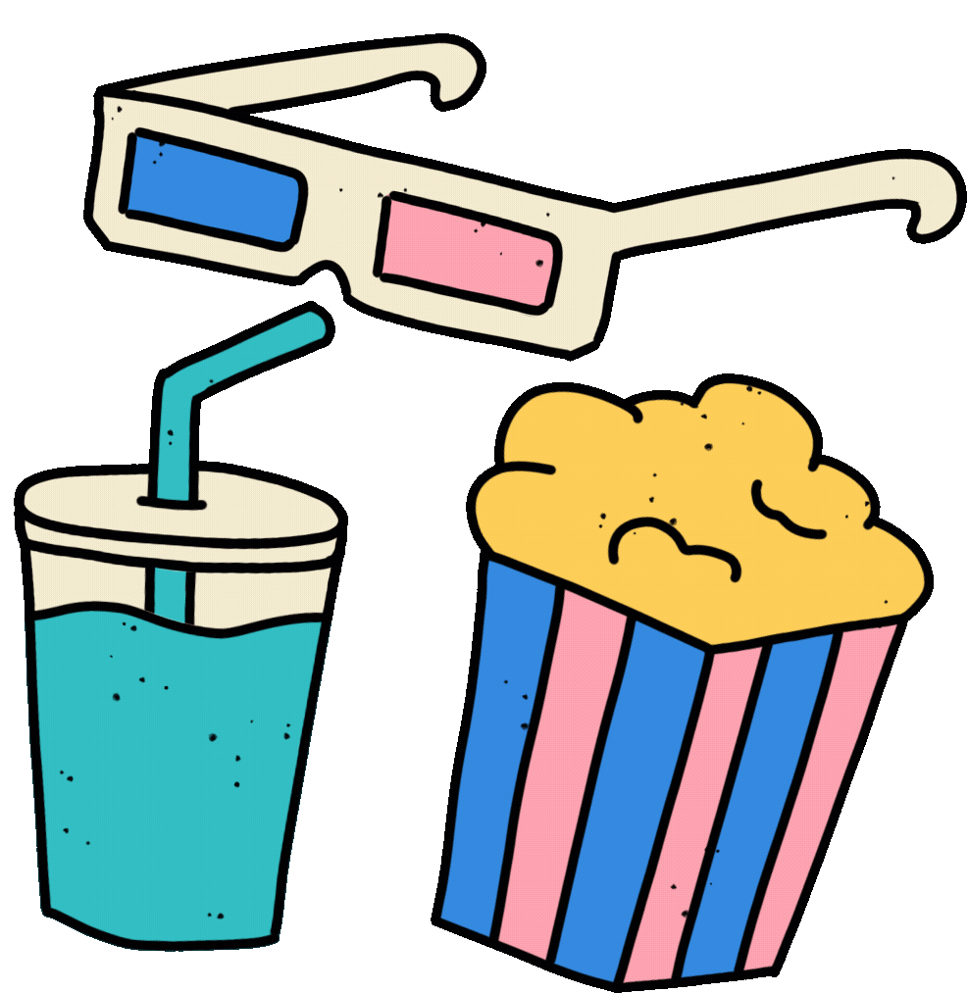
RECOMMENDATIONS
Enhanced Personalization: Strengthen the personalization of recommendations by exploring more granular user attributes. Consider incorporating demographic data, viewing history, and even contextual data like time of day. These factors can lead to hyper-personalized suggestions, enhancing user engagement.
Enable continuous learning. This means allowing the model to learn and improve over time as it receives more data and feedback from users. This can be done by updating the model's parameters based on new data and feedback. By enabling continuous learning, the model can keep the recommendations up-to-date and relevant.
Feedback Loop Implementation: Establish a feedback mechanism where users can provide explicit feedback on recommended movies. This feedback loop can help the platform fine-tune its recommendations and continuously improve the recommendation system's performance.

Slide 18

PRESENTED BY:
PEGGY OBAM
IVY KEMUNTO
JARED BII
JOY KAMAU
IMMANUEL OMONDI

Slide 19

THANK YOU!

